Slide 1
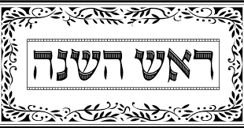
Rosh Hoshana

Slide 2
What is Rosh Hoshana?
Rosh Hoshana is the Jewish New Year
Also known as the Day of Judgement
Second Holiest Jewish holiday

Slide 3
Why is the Jewish New Year different from our New Year?
Rosh Hoshana, the Jewish New Year, is celebrated by following the lunar calendar (moon cycles)
Ironically, Rosh Hoshana is celebrated in the seventh month of the lunar calendar

Slide 4
How do you Celebrate Rosh Hoshana?
Rosh Hoshana starts the evening before the actual day, and lasts two days
During this time, most people attend Temple and celebrate with family and friends
Special foods are prepared and served to symbolize the New Year
The Books of Life and Death are opened and closed again on Yom Kippur
Typically wear white to symbolize purity of sin

Slide 5
How do you Celebrate Rosh Hoshana?
Typical to ask for forgiveness for things we’ve done wrong
Time of reflection to not make the same mistakes again in the upcoming New Year
Rosh Hoshana is two days and is followed by Ten Days of Repentance
Culminates in the Holiest Holiday, Yom Kippur, which is the Day of Atonement

Slide 6
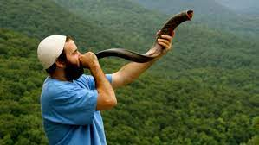
Blowing the Shofar
The Shofar is made of a ram’s horn, and is blown each day of Rosh Hoshana 100 times throughout the Temple Service
Symbolizes a “wake-up call” to repent and change your ways

Slide 7
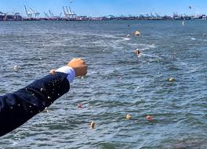
Tashlich
Following the first day of Temple services, it is customary to throw bread crumbs into flowing water
The bread crumbs symbolizes someone’s sins

Slide 8
Tzedekah
Give charity to people in need

Slide 9
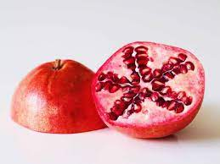
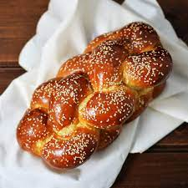
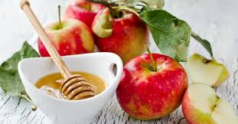
Typical Foods on Rosh Hoshana
Apples and Honey to symbolize a sweet New Year
Eating pomegranate to symbolize something new
Challah bread to symbolize eternal cycle of life

Slide 10
Additional Resources
Forget Me Not Youtube Channel: https://youtube.com/playlist?list=PL69u_ryL5PfEaP_pScAXvwGnW3je_eOz3
Subscriptions to Jewish Temple Services
Blowing of the Shofar
Typical Rosh Hoshana Foods
Tashlich Service

Slide 11
How to Celebrate Rosh Hoshana in Your Community
Learn about Rosh Hoshana
Provide online or in-person services to those celebrating the holiday or wishing to participate
Eat Apples & Honey and Challah bread
Consider doing an apple related craft (i.e painting with apples)
Conduct your own Tashlich service and have residents ask for forgiveness
Provide a charity project for your local community

