Slide 1
Canada Day Trivia

Slide 2
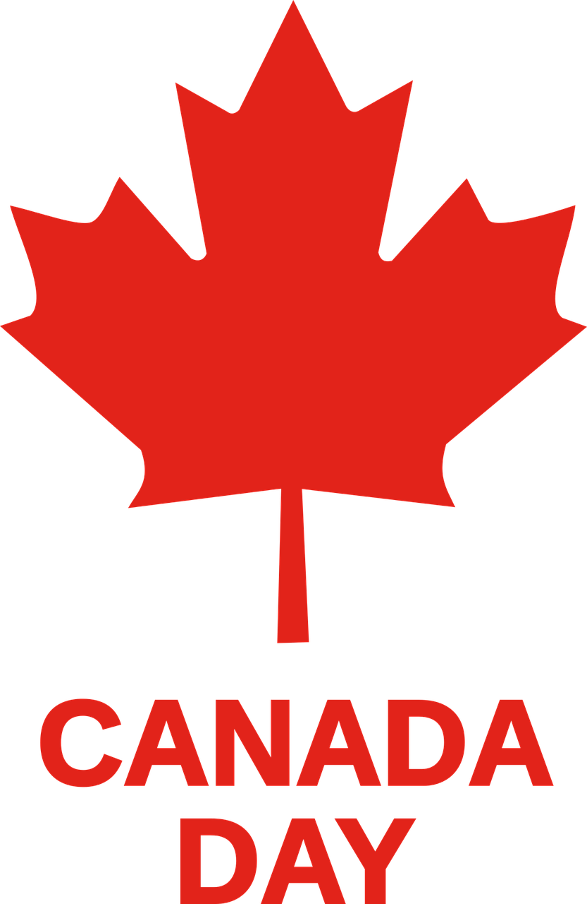
What animal is on the Canadian Quarter?

Slide 3
How many oceans touch Canada?

Slide 4
How many countries border Canada?

Slide 5
How many provinces are in Canada?

Slide 6
What is the national capital of Canada?

Slide 7
How many territories are in Canada?

Slide 8
What leaf is on the Canadian flag?

Slide 9
What is the Canadian national anthem called?

Slide 10
What measurement is used in Canada to measure temperature?

Slide 11
How many national languages does Canada have?

Slide 12
What are Canada’s national languages?

Slide 13
How many time zones does Canada have?

Slide 14
How many national parks are in Canada?

Slide 15
What is the name of the highest mountain in Canada?

Slide 16
Which Canadian City is considered “Hollywood North”?

Slide 17
How many points does the maple leaf on the flag have?

Slide 18
Which Canadian chain first opened in Hamilton in 1964?

Slide 19
What is Canada’s national sport?

Slide 20
Canada is the largest exporter of what fruit?

Slide 21
What is Canada’s oldest city?

Slide 22
Which Canadian city has the most tourists?

Slide 23
80% of the world’s supply of what comes from Canada?

Slide 24
What is the oldest walled city that still exists north of Mexico?

Slide 25
What major sporting event was held in Canada in 2010?

Slide 26
What is the world’s tallest tower?

